Slide 1
The Analysis and Design of Computer Algorithms
CIS*3490 Winter 2021

Slide 2
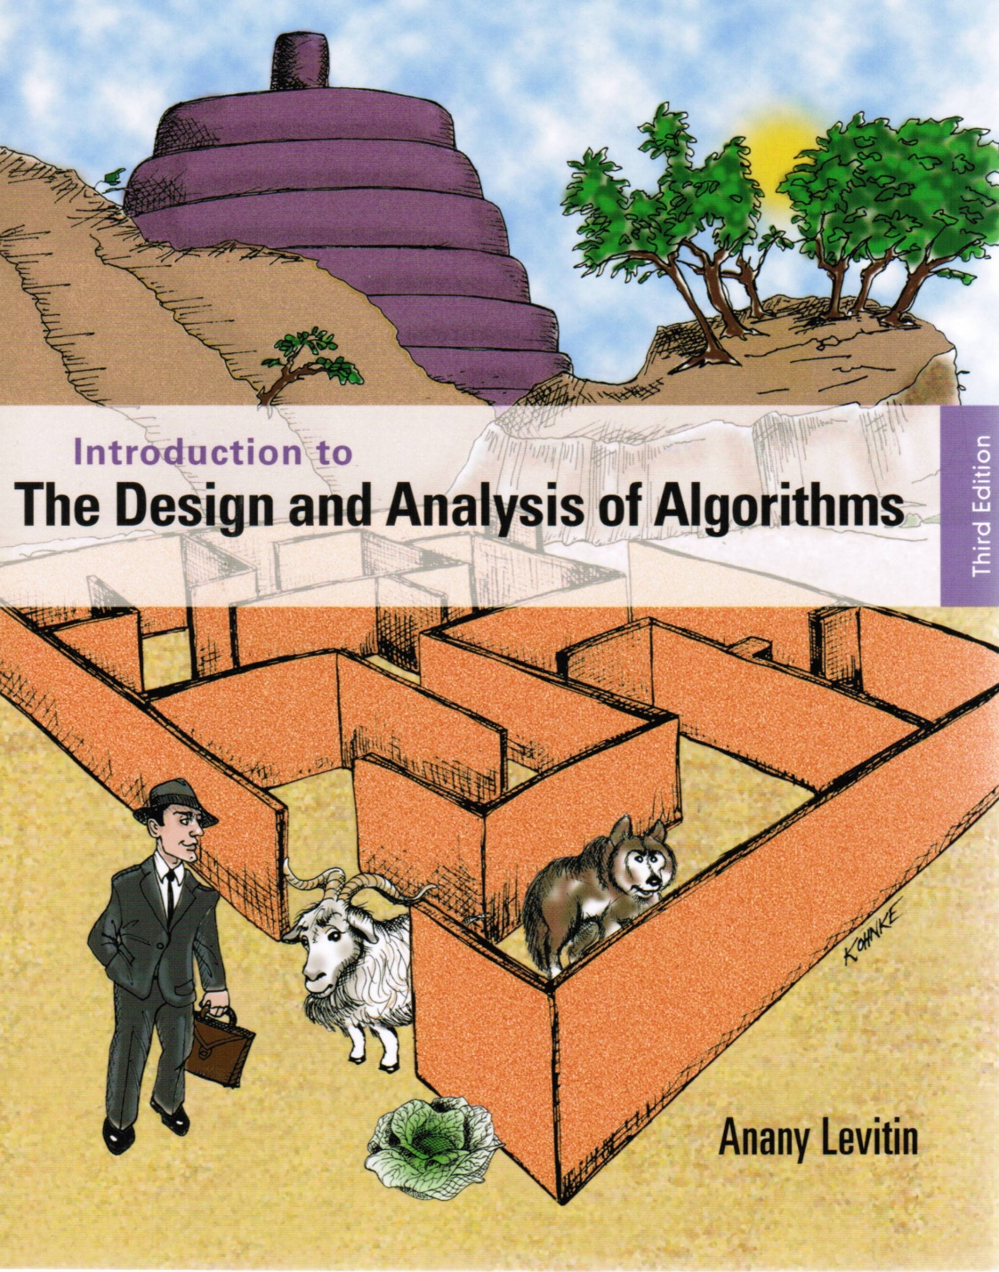
Chapter 4
Decrease and
Conquer

Slide 3

Decrease-and-Conquer
Reduce problem instance to a smaller instance of the same problem
Solve the smaller instance
Extend solution of smaller instance to obtain solution to the original instance

Slide 4
Decrease-and-Conquer (cont.)
Problem instance
of size n
Sub-instance
of size n-1
a solution to
the sub-instance
a solution to the original
problem instance

Slide 5
Decrease-and-Conquer (cont.)
Problem instance
of size n
Sub-instance
of size n/2
a solution to
the sub-instance
a solution to the original
problem instance

Slide 6
3 Types of Decrease and Conquer
Decrease by a constant (usually by 1):
insertion sort
topological sorting
algorithms for generating permutations, subsets
Decrease by a constant factor (usually by half)
binary search tree
binary search
exponentiation by squaring
Variable-size decrease
Euclid’s algorithm

Slide 7
Insertion Sort
To sort array A[0..n-1], sort A[0..n-2] recursively and then insert A[n-1] in its proper place among the sorted A[0..n-2]
Usually implemented bottom up (non-recursively)
Example: Sort 6, 4, 1, 8, 5 6 | 4 1 8 5
4 6 | 1 8 5
1 4 6 | 8 5
1 4 6 8 | 5
1 4 5 6 8

Slide 8
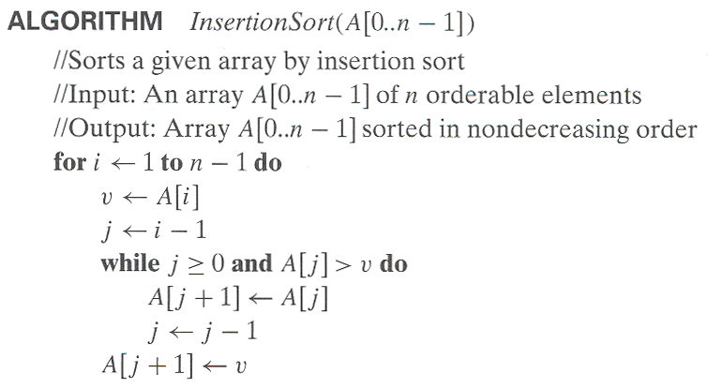
Pseudocode of Insertion Sort

Slide 9

Best Case of Insertion Sort
1 | 2 3 4 5 6 7 8
1 2 | 3 4 5 6 7 8
1 2 3 | 4 5 6 7 8
1 2 3 4 | 5 6 7 8
…
$$C_{best}\left(n\right)= \sum_{i=1}^{n−1}{1}=n−1 ∈ Θ(n)$$

Slide 10

Worst Case of Insertion Sort
8 | 7 6 5 4 3 2 1
7 8 | 6 5 4 3 2 1
6 7 8 | 5 4 3 2 1
5 6 7 8 | 4 3 2 1
…
$$C_{worst}\left(n\right)=\sum_{i=1}^{n−1}{\sum_{j=0}^{i−1}{1}}=\sum_{i=1}^{n−1}{i}=n\left(n−1\right)/2 ∈ Θ(n^{2})$$

Slide 11
Analysis of Insertion Sort
Time efficiency
C_{worst}(n) = n(n-1)/2 ∈ Θ(n²)
C_{avg}(n) ≈ n²/4 ∈ Θ(n²)
C_{best}(n) = n - 1 ∈ Θ(n) (also fast on almost sorted arrays)

Slide 12
DAGs and Topological Sorting
a
b
a
b
a DAG
not a DAG
c
d
c
d
DAG: a directed acyclic graph, i.e. a directed graph with no (directed) cycles
DAGs can be used to model many problems that involve prerequisite constraints, for example, construction projects, course prerequisite.
In topological sorting, vertices of a DAG are linearly ordered so that for every edge its starting vertex is listed before its ending vertex. Being a DAG is a necessary condition for topological sorting be possible.
a
b
c
d

Slide 13
DFS-based Algorithm
DFS-based algorithm for topological sorting
Perform DFS traversal, noting the order vertices are popped off the traversal stack
Reverse the order solves topological sorting problem
Back edges encountered?→ NOT a DAG!
Example:
Efficiency: same as efficiency of the DFS
a
b
e
f
c
d
g
h

Slide 14
DFS-based Algorithm
a
b
e
f
c
d
g
h
e
f
a
c
b
g
h
d
d
h
g
b
c
a
f
e
h
d
g
g
g
b
b
b
b
b
b
b
c
f
a
a
a
a
a
a
a
a
a
a
a
e
e
e
1
2
3
4
5
6
7
8
9
10
11
12
13
14
15
16

Slide 15
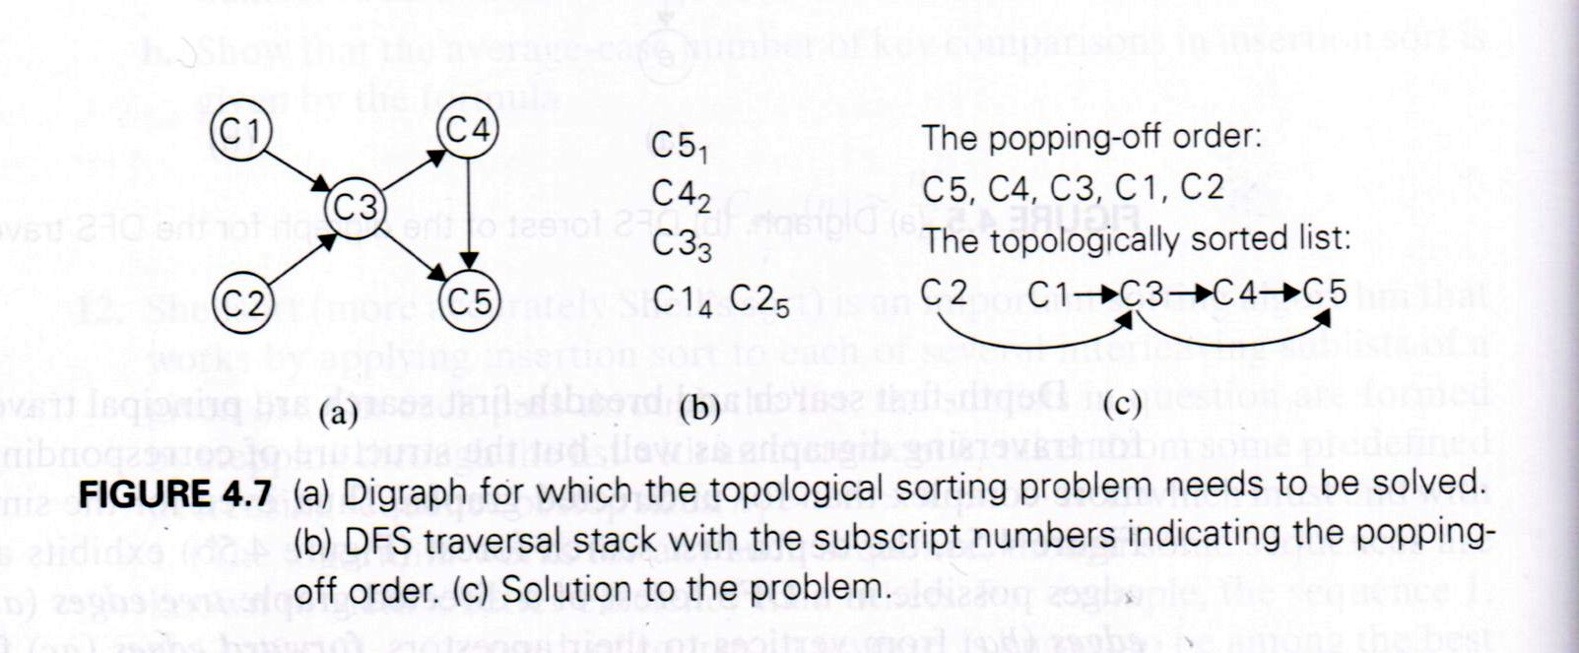
DSF-based Algorithm

Slide 16
Source Removal Algorithm
Source removal algorithm
Repeatedly identify and remove a source (a vertex with no incoming edges) and all the edges out-going from it until either no vertex is left (problem is solved) or there is no source among remaining vertices (not a dag)
Example:
Efficiency: same as efficiency of the DFS-based algorithm
a
b
e
f
c
d
g
h

Slide 17
Source Removal Algorithm
0
a
b
e
f
3
e
f
6
c
d
g
h
d
g
h
g
h
a
b
c
a
b
c
d
e
f
1
b
e
f
4
e
f
7
c
d
g
h
g
h
h
a
a
b
c
d
a
b
c
d
e
f
g
2
e
f
5
f
8
c
d
g
h
g
h
a
b
a
b
c
d
e
a
b
g
h
c
d
e
f

Slide 18
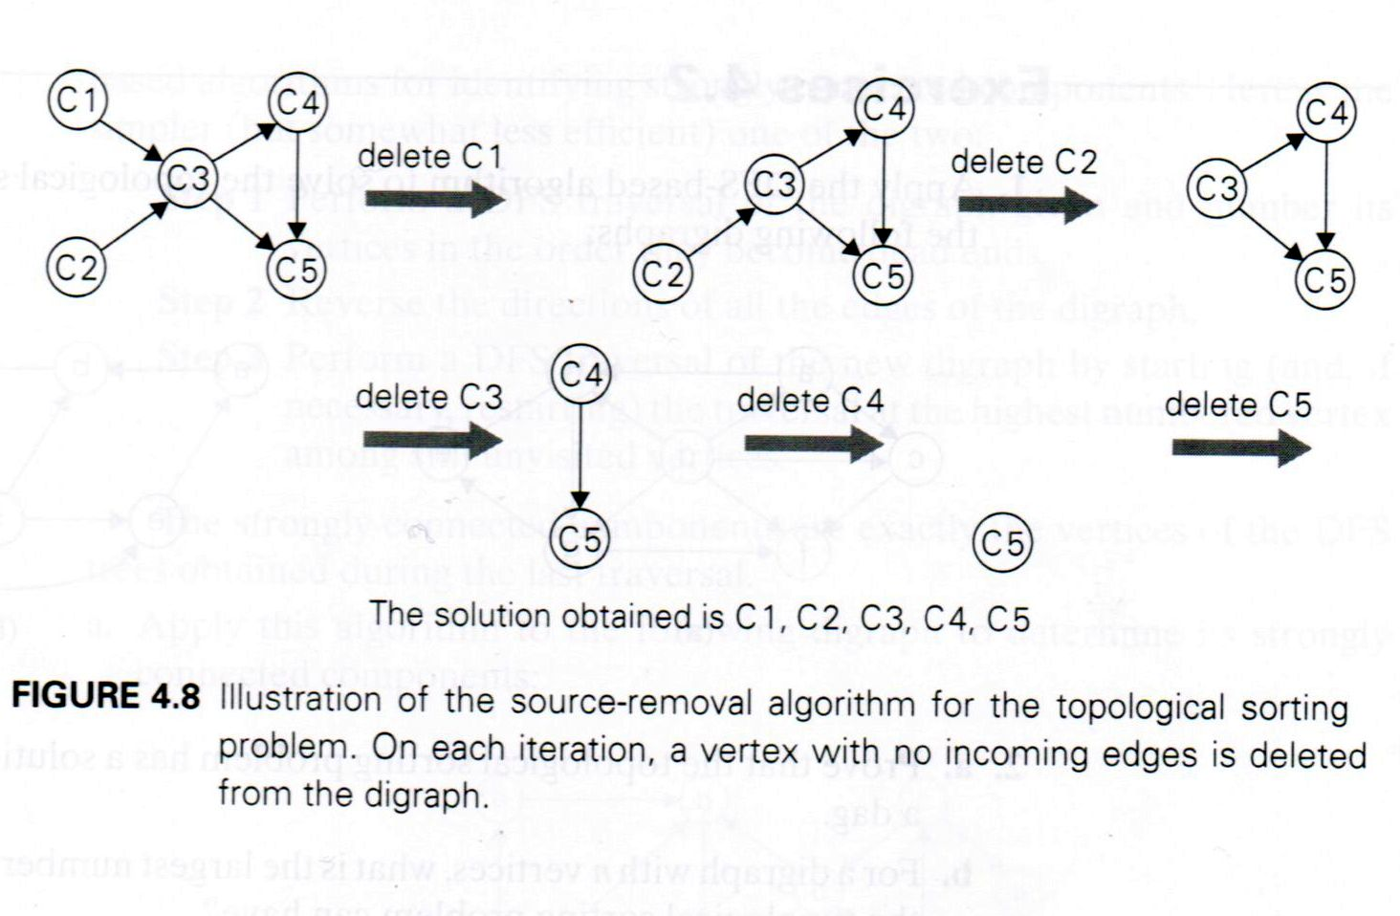
Source Removal for Topological Sorting

Slide 19
Topological Sorting Example
Order the following items in a food chain
tiger
plankton
shrimp
fish
wheat
sheep
human
tiger
human
fish
sheep
shrimp
plankton
wheat
wheat
sheep
plankton
shrimp
fish
human
tiger

Slide 20
Searching in Binary Search Tree
Algorithm BTS(x, v)
//Searches for node with key equal to v in BST rooted at node x
if x = NIL return -1
else if v = K(x) return x
else if v < K(x) return BTS(left(x), v)
else return BTS(right(x), v)
Efficiency
worst case: C(n) = n
average case: C(n) ≈ 2ln n ≈ 1.39log₂ n
k
<k
>k

Slide 21
Binary Search
Very efficient algorithm for searching in sorted array:
K
vs
A[0] . . . A[m] . . . A[n-1]
If K = A[m], stop (successful search); otherwise, continue searching by the same method in A[0..m-1] if K < A[m] and in A[m+1..n-1] if K > A[m]
l ← 0; r ← n-1
while l ≤ r do
m ← ⎣(l+r)/2⎦
if K = A[m] return m
else if K < A[m] r ← m-1
else l ← m+1
return -1

Slide 22
Analysis of Binary Search
Time efficiency
worst-case recurrence: C_{w} (n) = 1 + C_{w}( ⎣n/2⎦ ), C_{w} (1) = 1
Solution: C_{w}(n) = ⎡log₂(n+1)⎤ This is VERY fast: e.g., C_{w}(10⁶) = 20
Optimal for searching a sorted array
Limitations: must be a sorted array (not linked list)

Slide 23

Exponentiation by Squaring
The problem: Compute a^{n} where n is a nonnegative integer
A brute force algorithm: a $×$ a $×$ a $×$ a $×$ a $×$ … $×$ a.
The algorithm does n – 1 multiplication.
A decrease-and-conquer algorithm for exponentiation:
a⁸ = (a^{8/2})²
= (a⁴ )²
= ((a^{4/2})²)²
= ((a²)²)²
= (((a^{2/2})²)²)²
= (((a¹)²)²)²
= (((a)²)²)²
a⁹ = (a^{(9-1)/2})² a
= (a^{8/2})² a
For even values of n
a ^{n} = (a ^{n/2} )² if n > 0 and a ⁰ = 1
For odd values of n
a ^{n} = (a ^{(n-1)/2} )² a
Recurrence: M(n) = M( ⎣n/2⎦ ) + f(n), where f(n) = 1 or 2,
M(1) = 0

Slide 24
Euclid’s Algorithm for GCD
The problem: Calculating the greatest common divisor (gcd) of two nonnegative, not-both-zero integers.
Euclid’s algorithm is based on applying repeatedly the equality
gcd(x,y) = gcd(y, (x mod y))
Example
gcd(60,24) = gcd(24,(60 mod 24)) = gcd(24,12) =
gcd(12,(24 mod 12)) = gcd(12,0) = 12

Slide 25

Recurrence Types in Algorithm Analysis
Decrease and Conquer (decreased by one)
T(n) = T(n-1) + f(n) (1)
Decrease and Conquer (decreased by a constant factor)
T(n) = T(n/b) + f(n) b $≥$ 2 (2)
Covered by the Master Theorem
Divide and Conquer
T(n) = a T(n/b) + f(n) a $≥$ 1, b $≥$ 2 (3)
Covered by the Master Theorem

Slide 26
Design techniques and problem types
 | Search | Sorting | Tree | Graph | Other
Brute force, exhaustive search | Sequential search, Sequential string match | Selection sort, Bubble sort |  | Traveling salesman problem, DFS, BFS | Knapsack problem, Assignment problem
Decrease and conquer | Binary search | Insertion sort | Binary search tree | Topological sorting | Exponentiation by squaring
Divide and conquer |  | Mergesort, Quicksort | Binary tree traversal |  | Matrix multiplication, Large integer multiplication, quickhull
Transform and conquer | Presorting | Heapsort | AVL tree, 2-3 tree |  | Gaussian elimination, Polynomial evaluation
Space and time tradeoff | Hashing, B-tree, Horspool algorithm | Sorting by counting
Dynamic programming |  |  | Optimal binary search trees | Warshall’s algorithm, Shortest paths problem | Knapsack problem, Memory functions
Greedy techniques |  |  |  | Minimum spanning tree | Huffman trees
Iterative improvement |  |  |  | Maximum flow Bipartite graphs | Stable marriage problem
Backtracking Branch & bound |  |  |  | Traveling salesman problem, | N-queens, Assignment, Knapsack

Slide 27
Recommended Reading
4.1
4.2
4.4 (binary search)

